Slide 1
Manual How to Choose diploma/bachelor theses in the UIS

Slide 2
1.) On the home page click on the Student´s portal

Slide 3
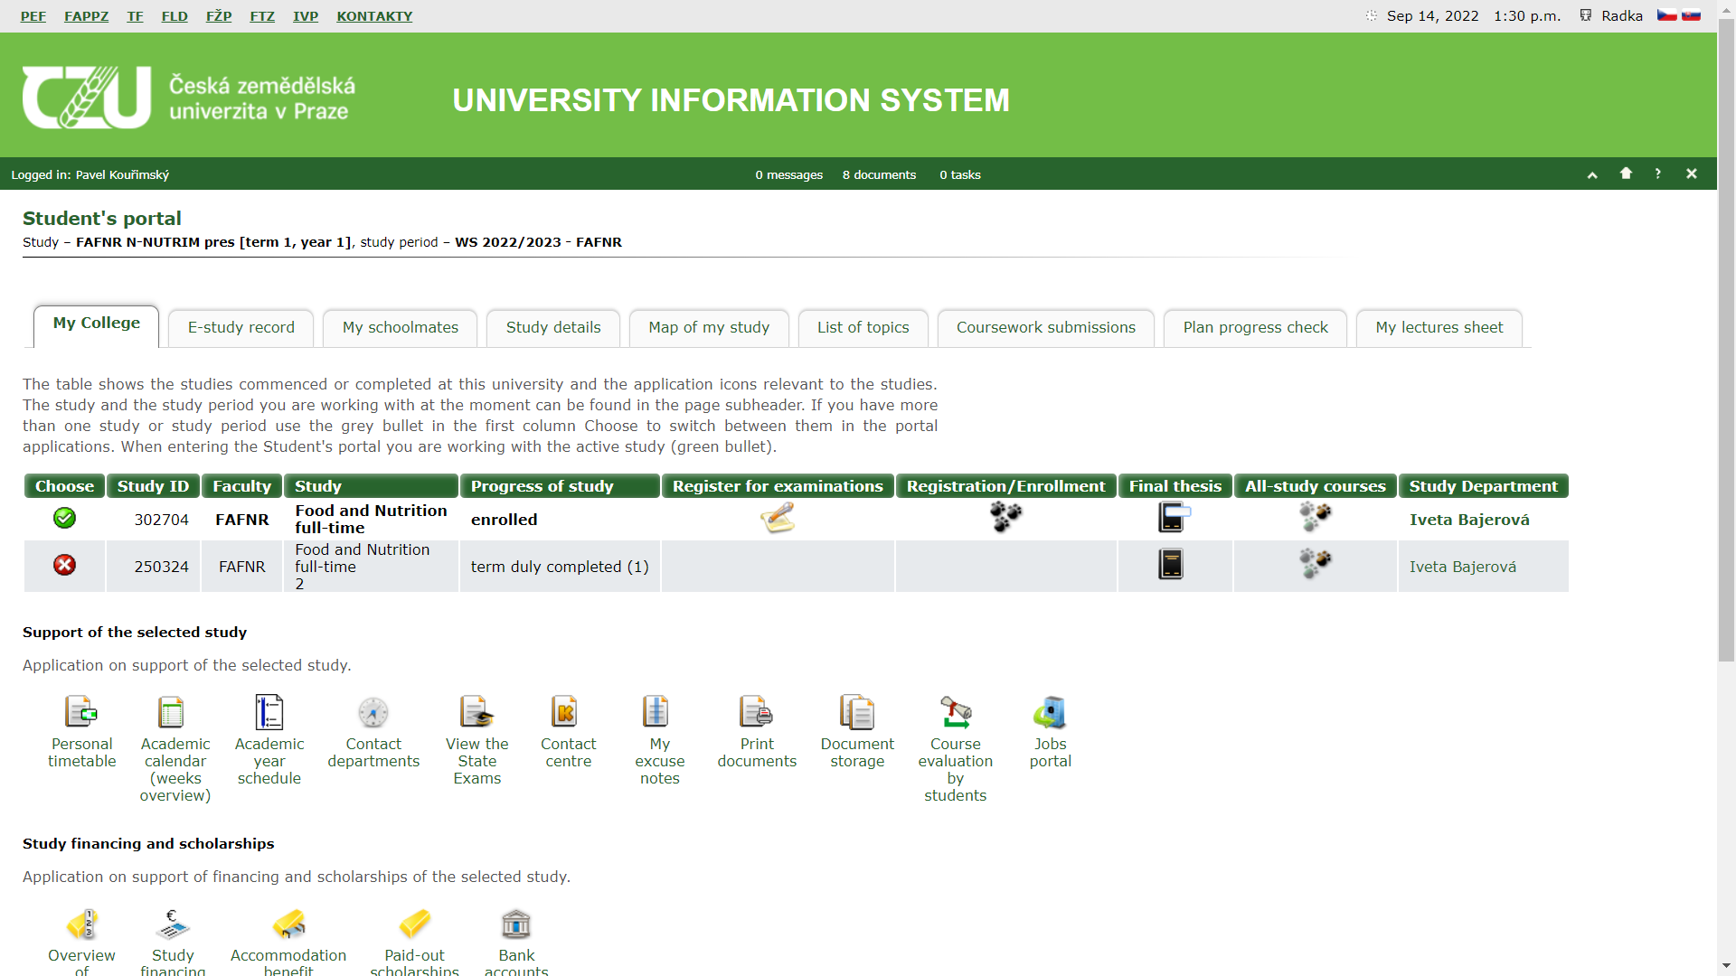
2.) Then, click on the List of topics

Slide 4
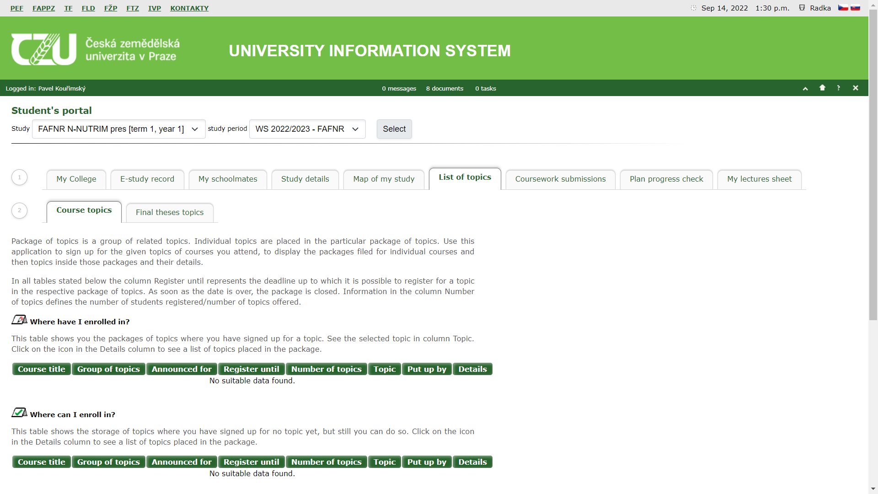
3.) Next, click on the tab Final theses topics

Slide 5
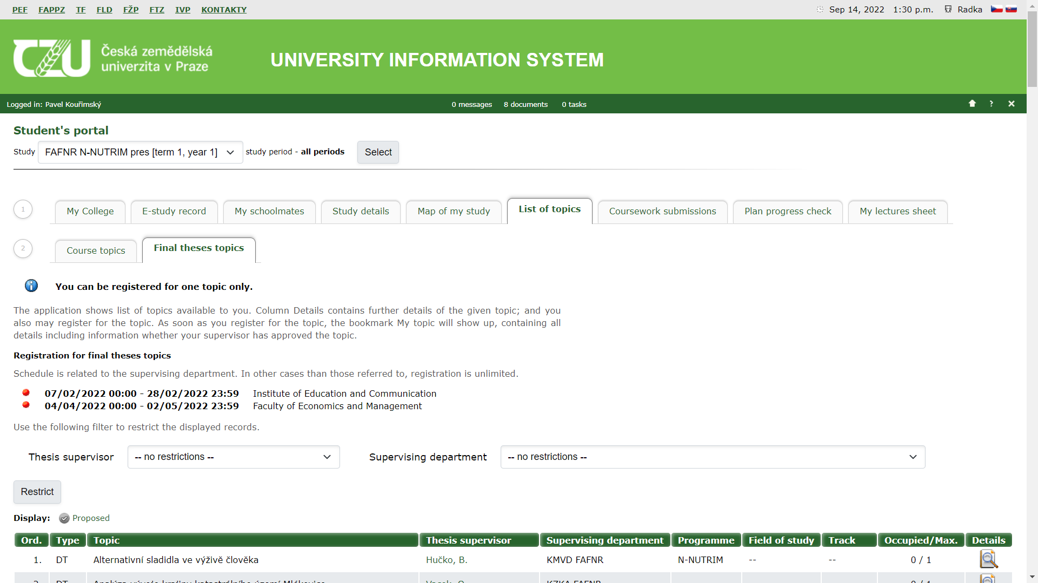
4.) Choose from the available topics in the list

Slide 6
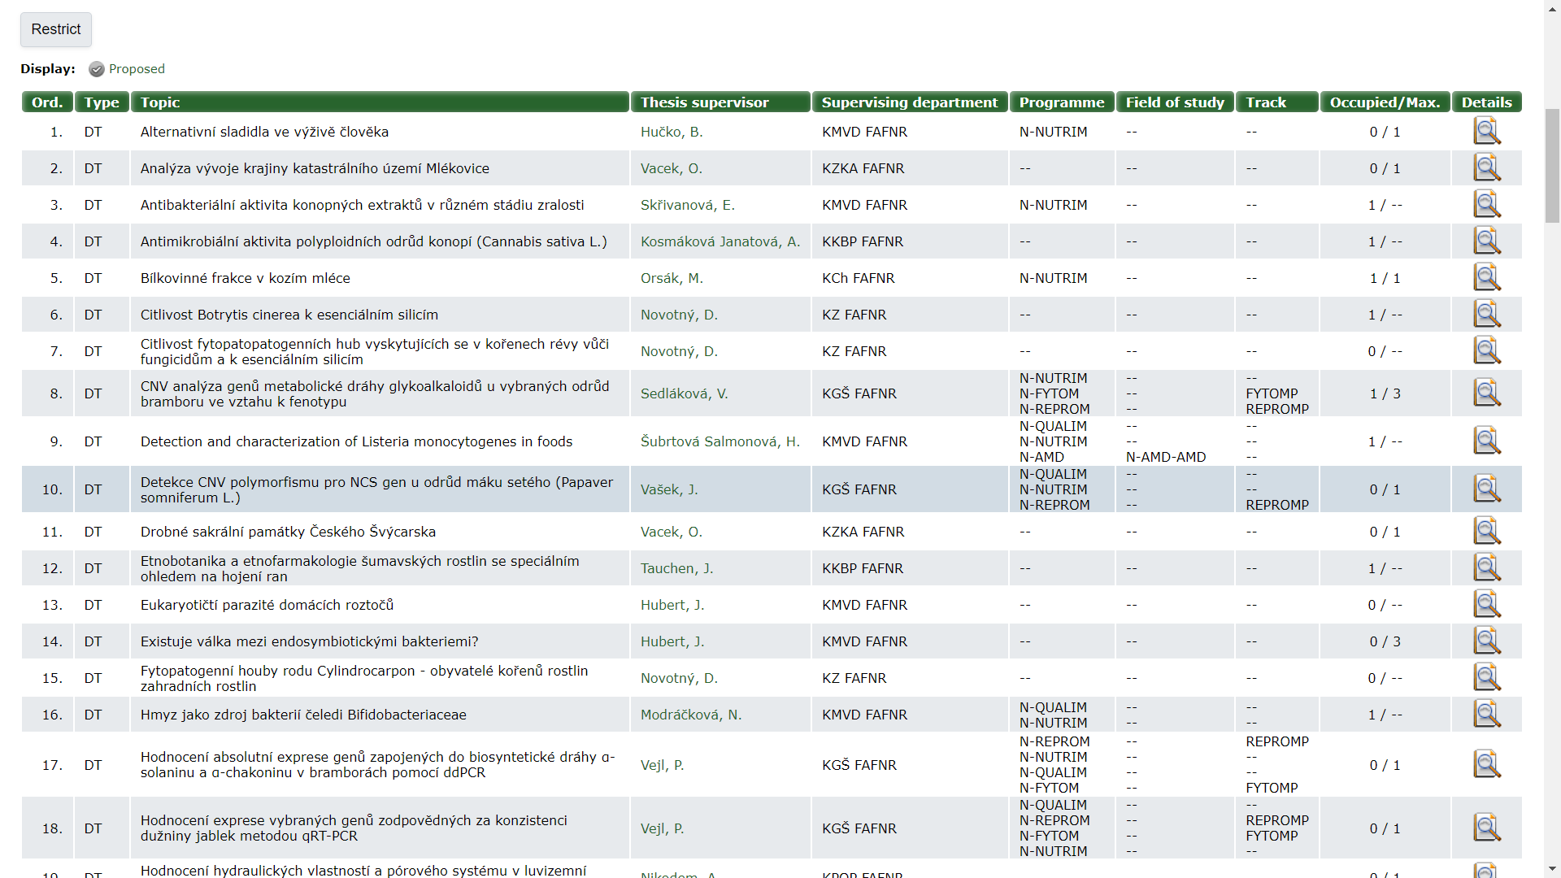
5.) On available topic click on the Details icon (paper with magnifying glass)

Slide 7
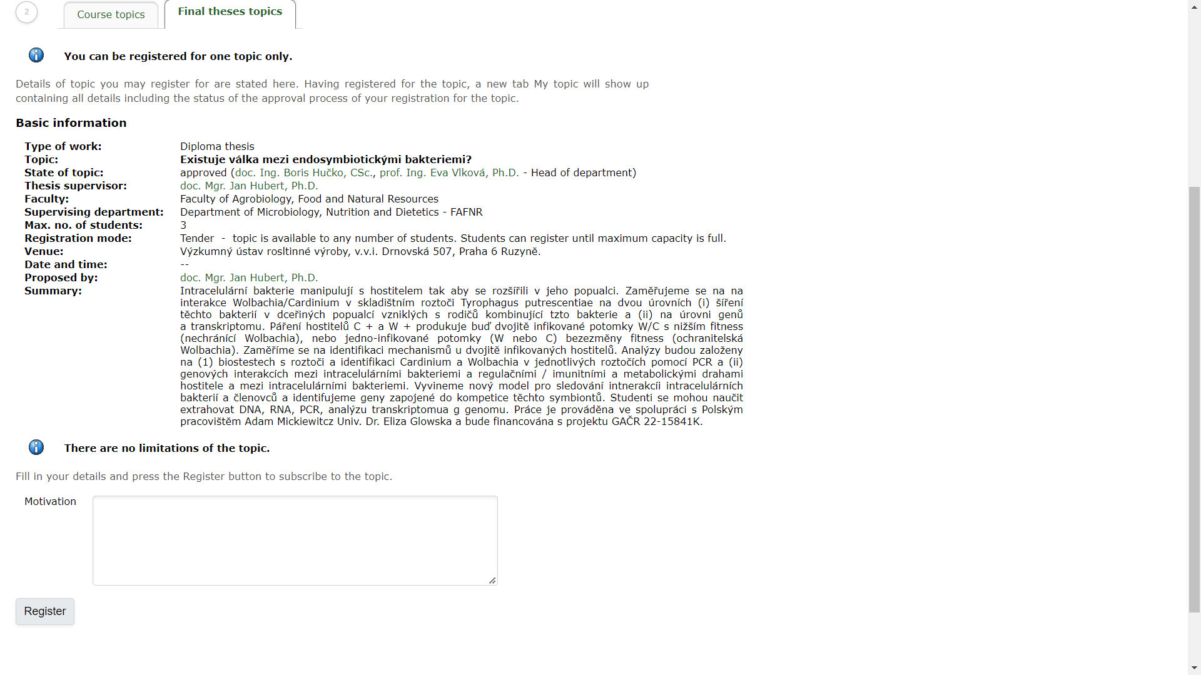
6a.) On the Details page, you can register for certain thesis via system.

Slide 8
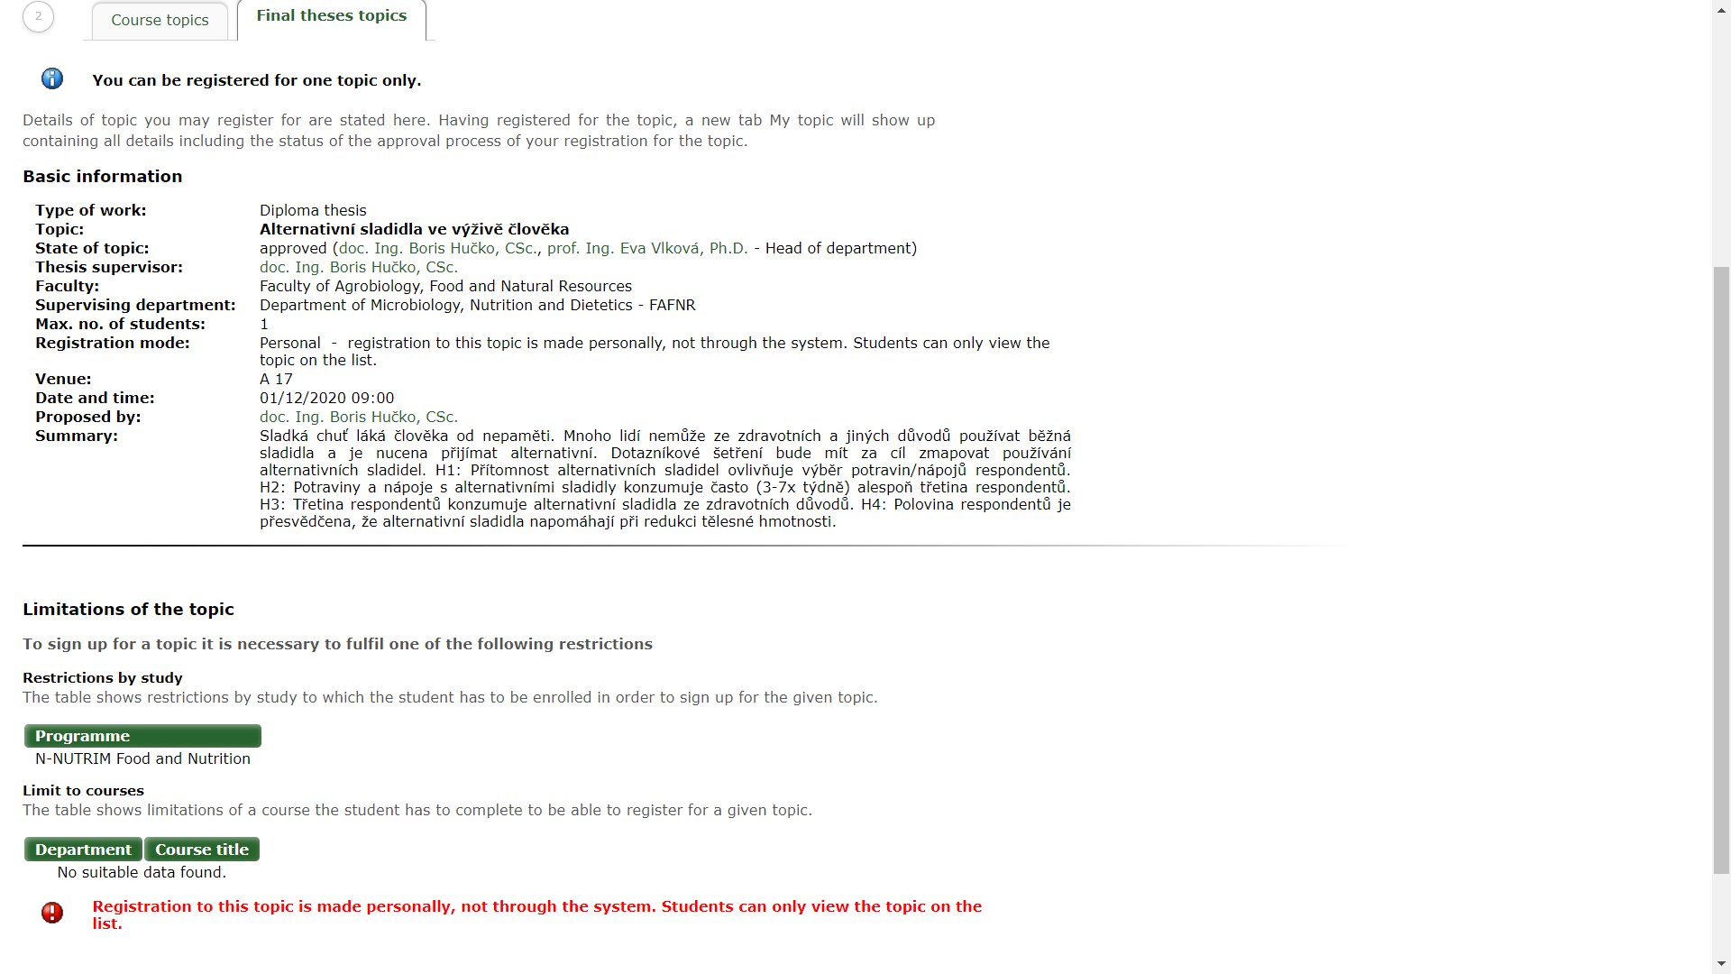
6b.) If there is no possibility to register via system, you have to contact the thesis supervisor.

Slide 9
7.) Final step
You have been assigned a thesis topic of your choice via the system or by thesis supervisor.
or
You have not been assigned the thesis topic you selected. Try to choose another topic. If there is no topic available in the list of offered topics, contact your study programme supervisor.

